Slide 1
Introduction:
We are students of Aptech IT and we would like to welcome you to our presentation. Today, we will be sharing with you our insights and findings on the topic that we have been working on. We hope that you find our presentation informative and engaging, and that it sparks interesting discussions and ideas. Thank you for being here with us today.

Slide 2
Group Members
Abdul Raffay S.
Sadia Bader
Wajiha Khadim Hussain

Slide 3
Problem Statement
Vinegar Food Restaurant which is the flagship brand of JADONS Ltd has spread over its aroma in this industry over the past few decades. Known as “the Serving plates” with 72 different rotating menus and 240000 delicacies throughout the country.
The organization wants a website to be made which should spread the aroma online. The main Highlights of the restaurant must be highlighted in the website. The restaurant has more than 1000 branches till date.

Slide 4
Requirements Specification
1) Home page must add header section with an image which would show different range of dishes images.
2) The menu list must be added in one section of the website
3) The bottom navigation panel must be designed.
4) You can add additional links as well as modify but make sure all the type of
food must be included.
5) Look and feel must be made user friendly.
6) Uniformity and Navigation must be made smooth throughout the website.
7) Site map, Gallery, about us, Queries link, Contact us link must be added.
8) Navigation of the website must be made user friendly.
9) Links such as
- Home
- About us
- Meals
i. Regular
ii. Lunch
iii. Snacks
iv. Desert
v. Beverages
- Gallery
- Awards
- Catering
- Recipe of the month
- Contact us
- Feedback (can add query, suggestion or complaints)

Slide 5
Header
Specifications:
Responsive Design
Includes Logo and Navigation Links
Fulfills All Requirements
Clear and concise and Easy Navigation
Uses Custom Hamburger Menu
Minimalistic Design uncluttered layout that allows users to easily navigate the menu and find what they are looking for.

Slide 6
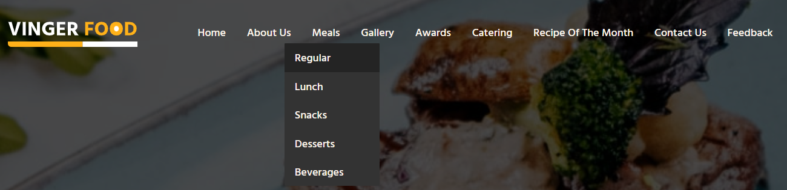
Header
Screen Shot:
Desktop:

Slide 7
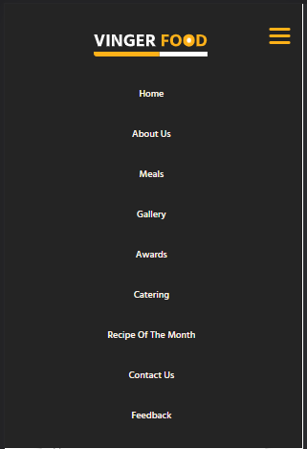
Header
Screen Shot:
Responsive:

Slide 8
Home Page
Specifications:
Has Multiple different sections
The Hero section is displayed prominently at the top with changing background image.
Animated Design
5 Other Sections Excluding Header and Footer
Fully Responsive design for both mobiles and Tablet Devices

Slide 9
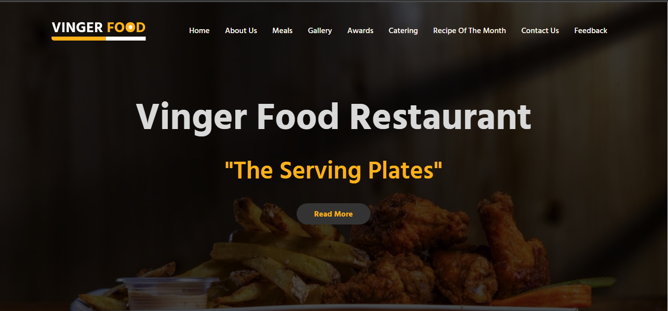
Banner
Screen Shot:

Slide 10
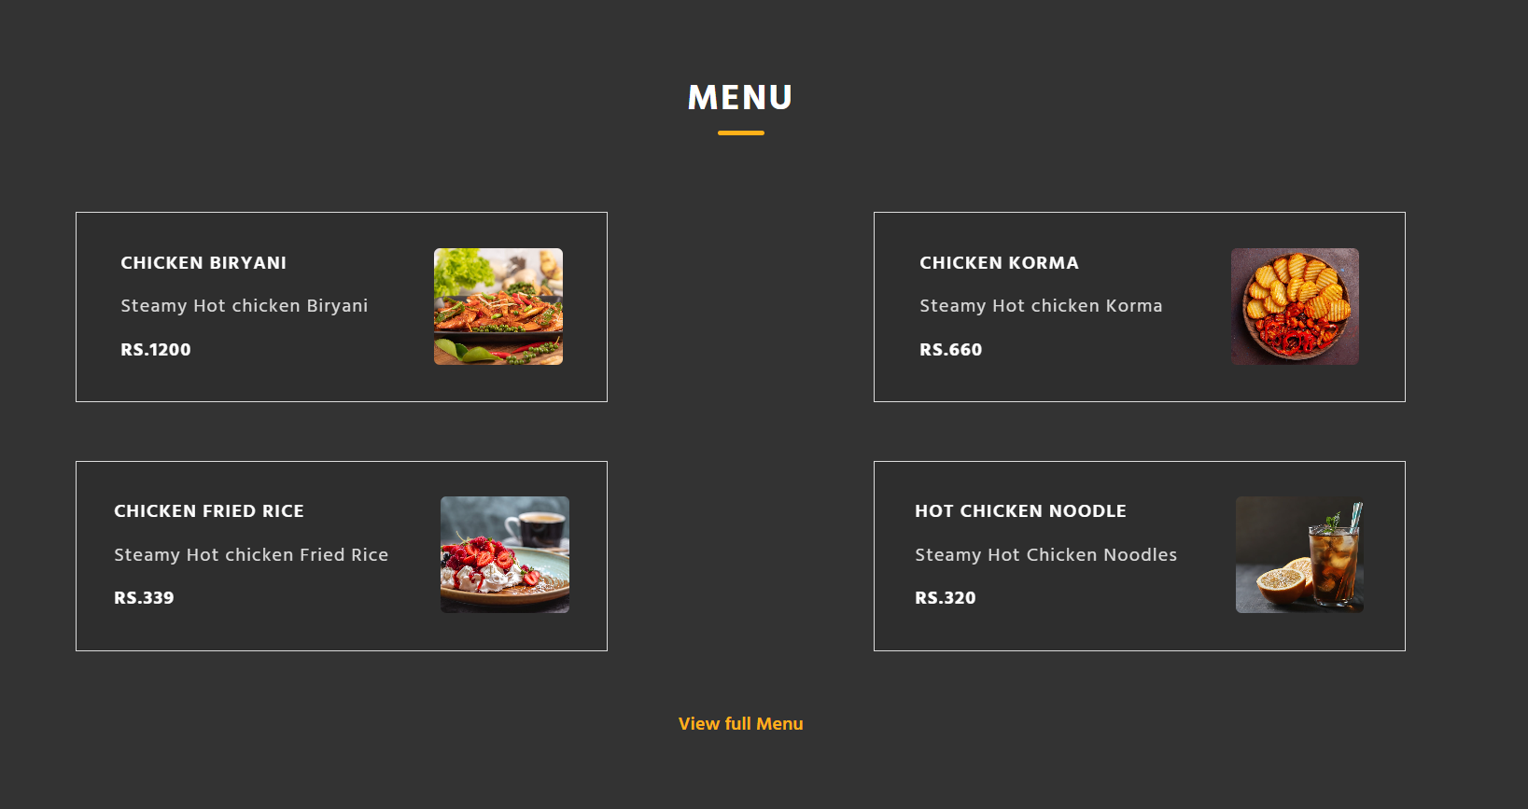
Menu
Screen Shot:

Slide 11
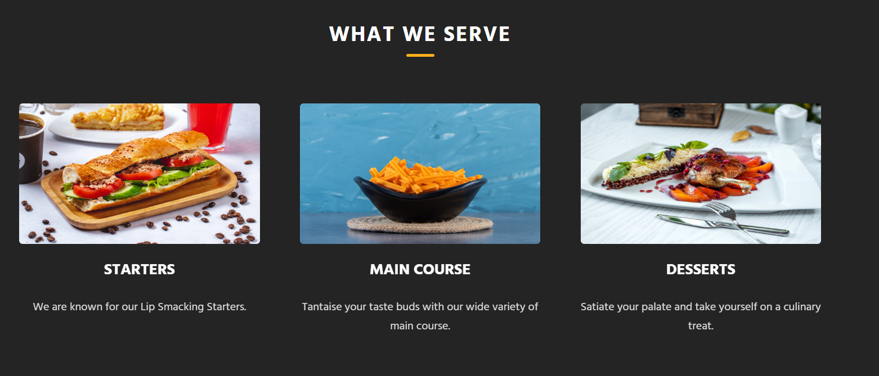
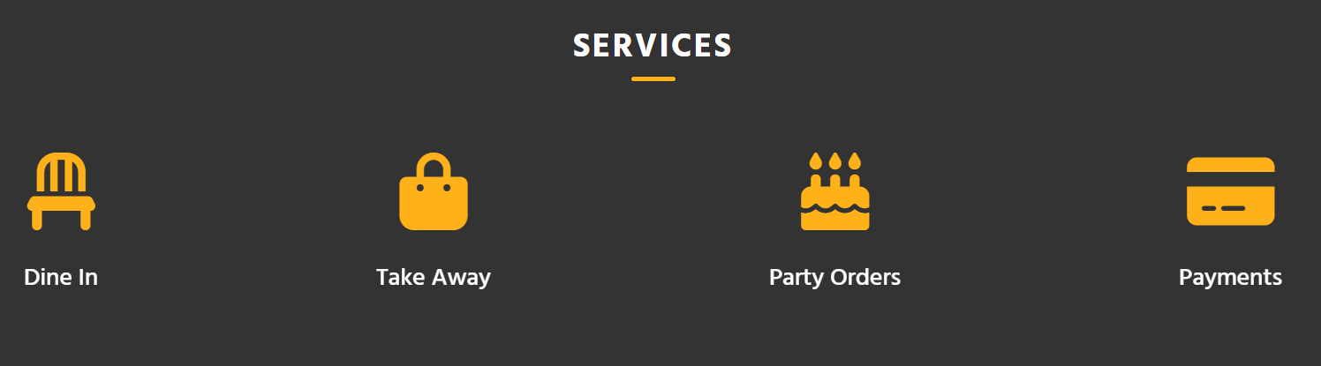
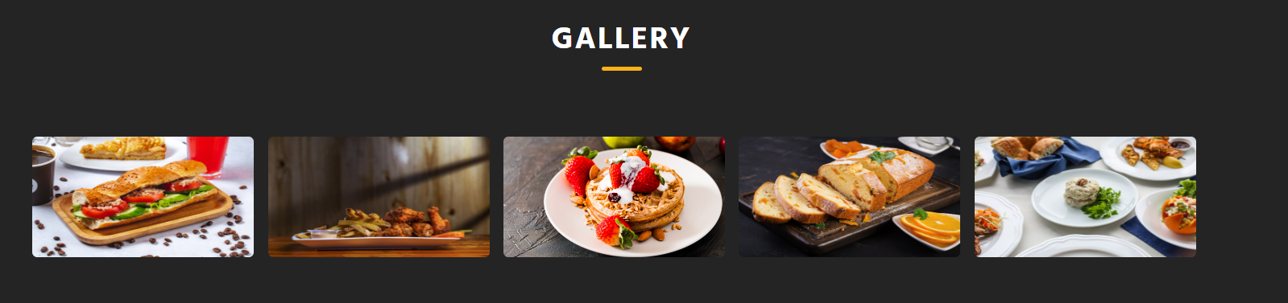
Other Home Sections
Screen Shot:

Slide 12
About Us
Specifications:
Fully Responsive
Provides users information about our restaurant
Minimalist Design

Slide 13
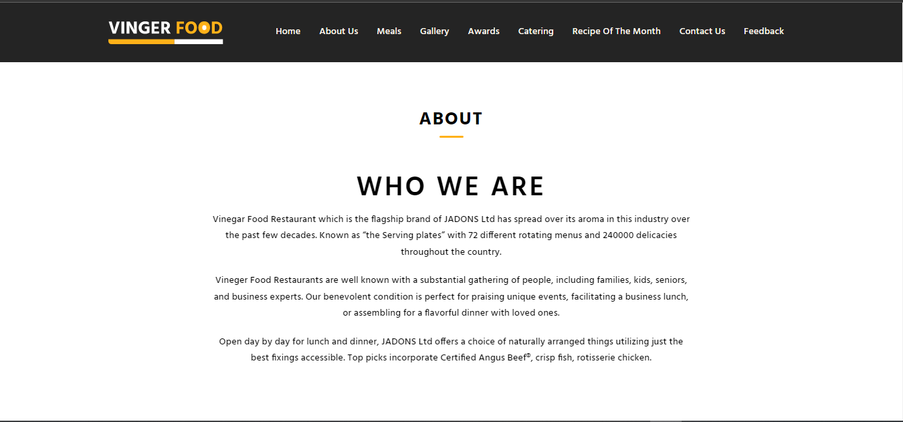
About Us
Screen Shot:

Slide 14
Meals
Specifications:
Fully Responsive Design
This page shows user different range of food Available.
All the categories are mentioned as per design
Multi Navigation- User Can use both this page and Navigation bar to reach the desired sub page
The pages includes: Regular, Lunch, Snacks, Desserts and Beverages subpages.

Slide 15
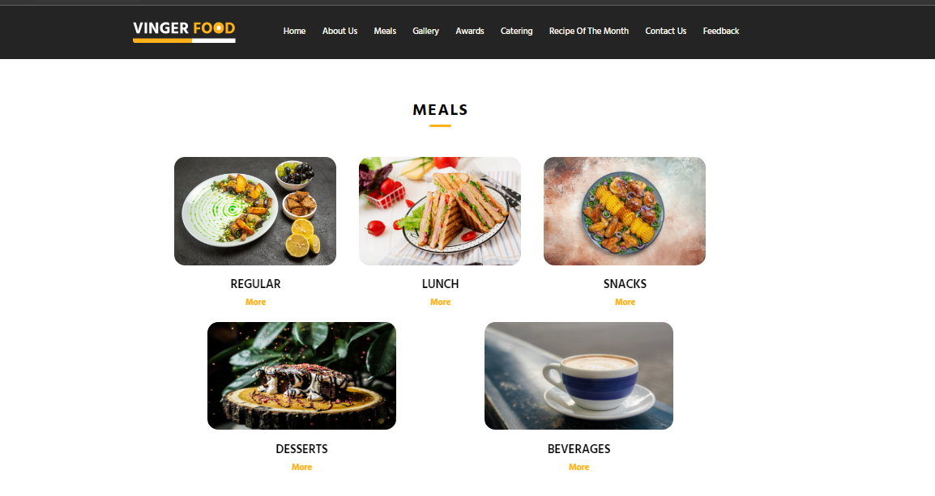
Meals
Screen Shot:

Slide 16
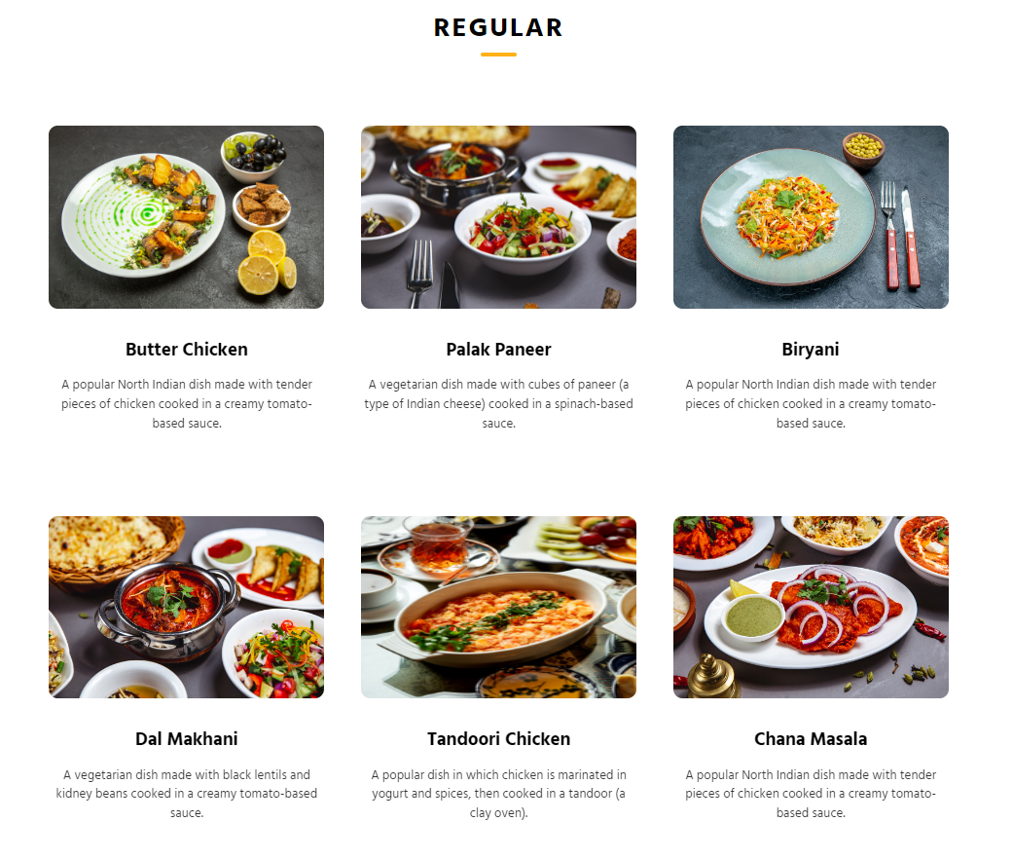
Meals-Subpage
Screen Shot:

Slide 17
Gallery/Awards/Catering/Recipe
Specifications:
Fully Responsive Design
These pages are used to give users insight of the restaurants food.
All the of the pages are responsive.
They use different animations to make the website look more attractive.

Slide 18
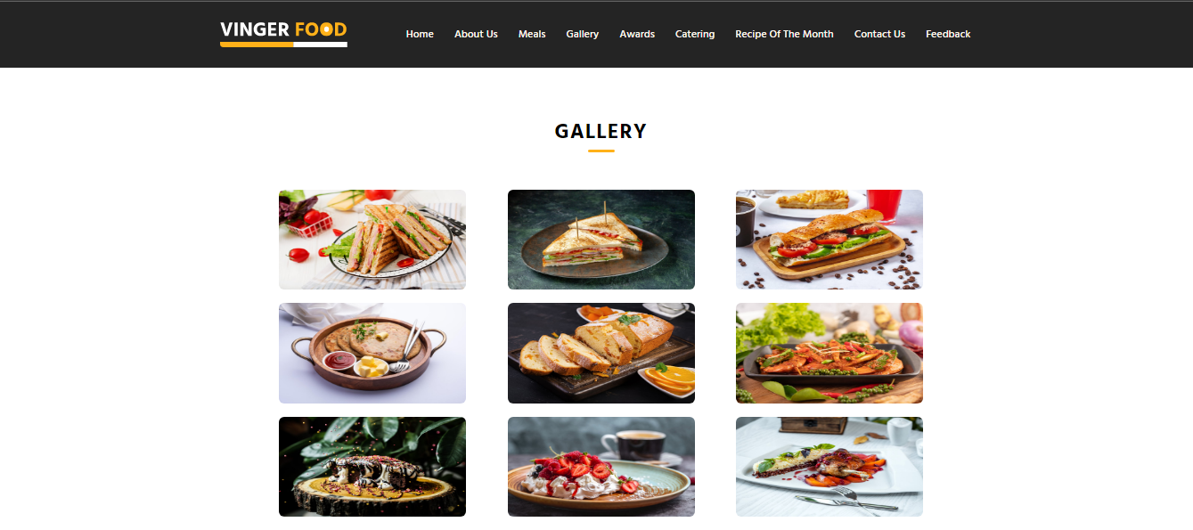
Gallery
Screen Shot:

Slide 19
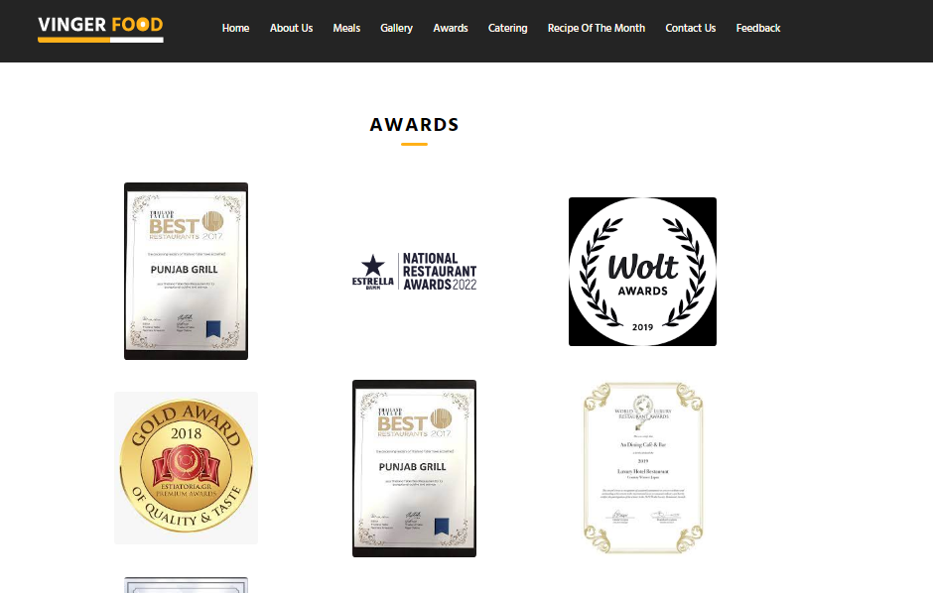
Awards
Screen Shot:

Slide 20
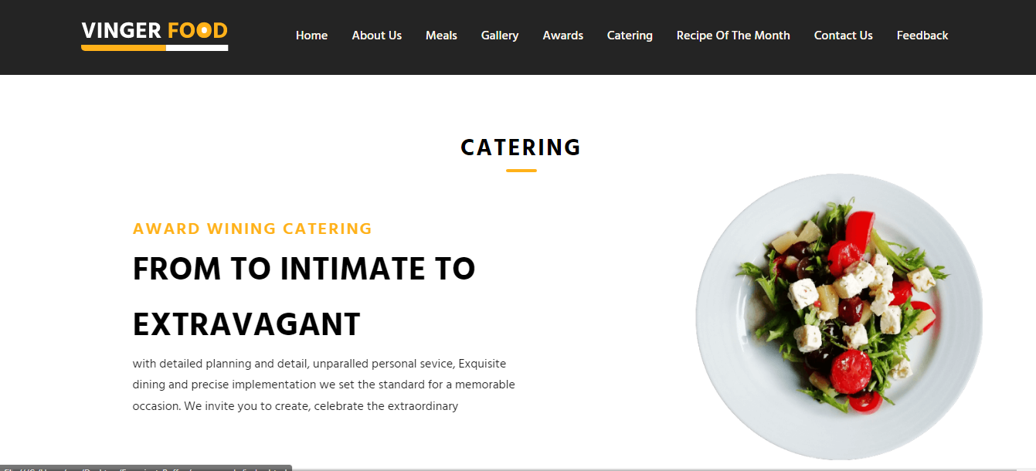
Catering
Screen Shot:

Slide 21
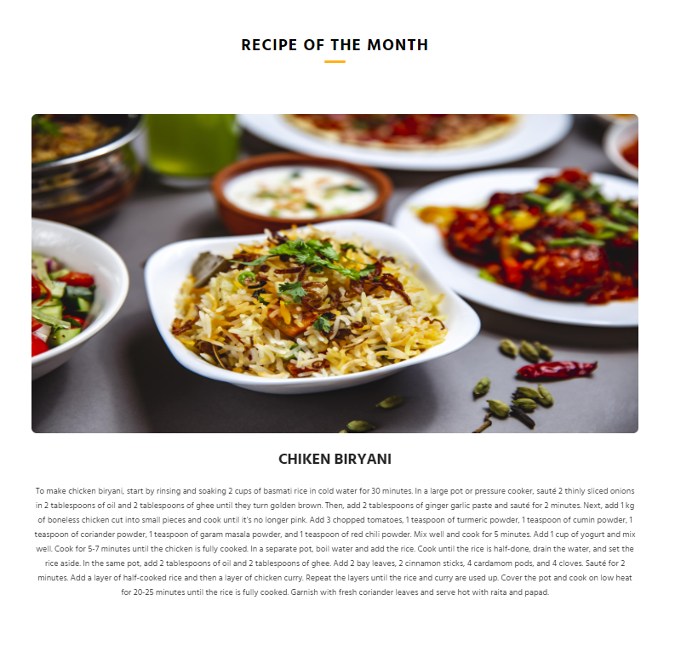
Recipe of the month
Screen Shot:

Slide 22
Contact Us/Sitemap/Feedback
Specifications:
Fully Responsive Design
Firstly, The contact us page can be used by the user to send queries and make reservations. The same page has a different section of sitemap.
Feedback: User can use this page to provide feedback using multiple options given to them.

Slide 23
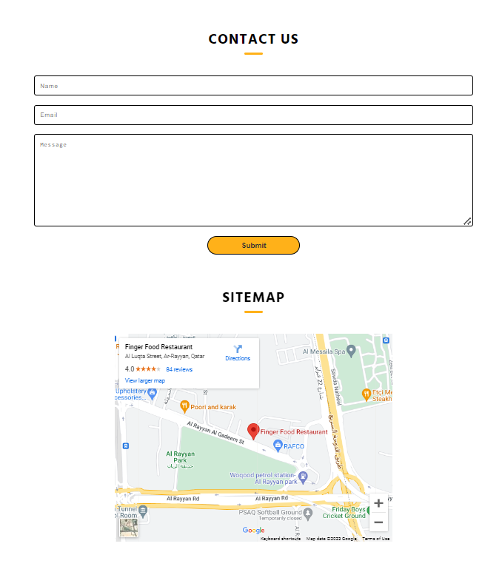
Contact Us/Sitemap
Screen Shot:

Slide 24
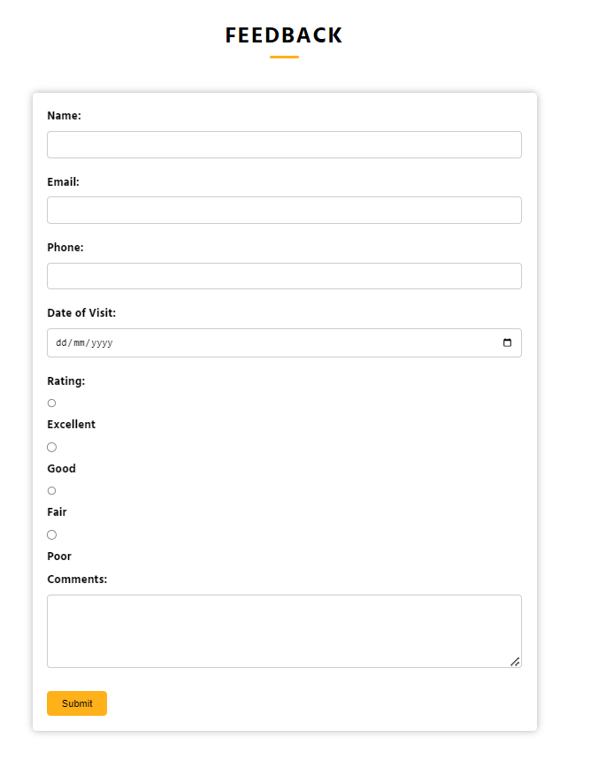
Feedback
Screen Shot:

Slide 25
Footer
Specifications:
Responsive Design
Has two sections top and bottom footer
Provides crucial information to the user
Provides different social links to the user
Minimalistic Design uncluttered layout that allows users to easily navigate the menu and find what they are looking for.

Slide 26
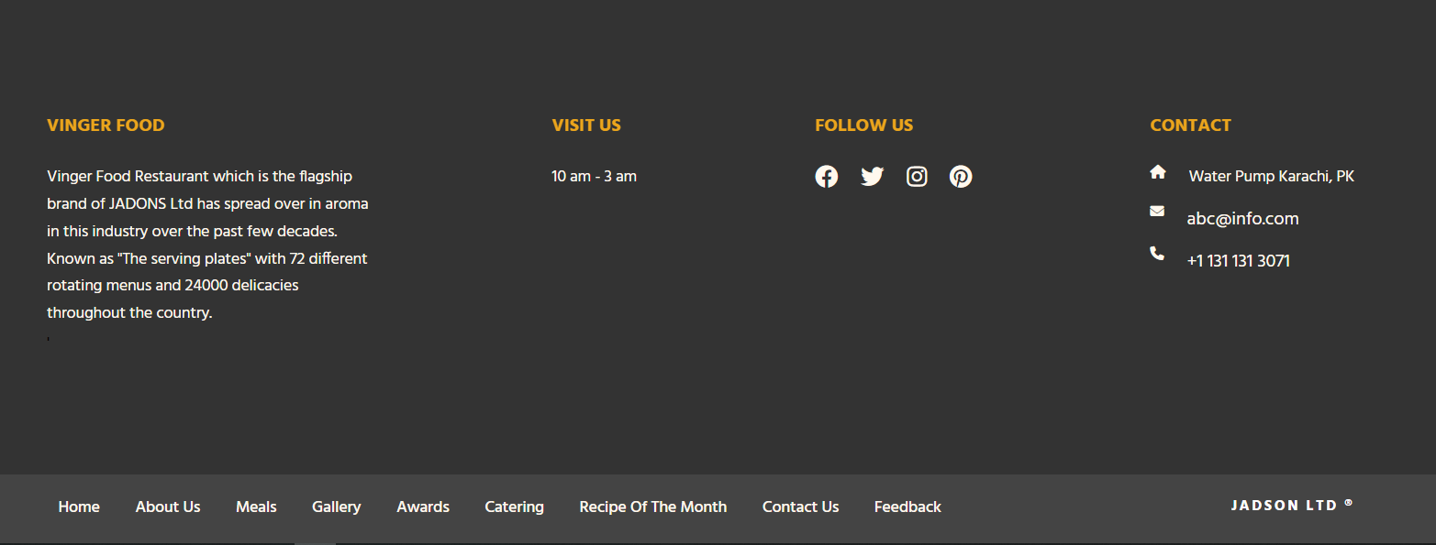
Footer
Screen Shot:
Desktop:

Slide 27
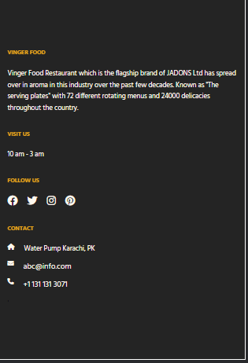
Footer
Screen Shot:
Responsive:

